Slide 1

Prabal Ghosh Côte d'Azur University AIQDSC34 - ECUE More on Deep Learning Algorithms
https://arxiv.org/abs/2010.11929

Slide 2
Outline
Motivation for ViT
Vision Transformer architecture
Transformer Encoder
Computing Self-Attention: Example
Computing Multi-Head Attention: Example
Vision Transformer Architecture Explained
Training
Self-supervision
Training Dataset Vision Transformer
Pre-Training Vision Transformer
Image Classification Accuracies
Fine-tuning ViT
Training ViT
ViT vs ResNet
Inspecting ViT representations
Conclusion

Slide 3
Motivation:
The encoder-decoder architecture of Transformer achieved state of the art performance on machine translation tasks , by allowing significantly more parallelization (i.e less time to train).
RestNet (CNN) was the best solution for image classification.
Can we apply Transformers to images and get state-of-the-art results ?

Slide 4
Idea of the Paper:-
Use the Transformer Encoder architecture with fewest possible modifications and apply on image classification tasks.
Idea is to train Vision Transformer (ViT) on sufficiently large amounts of data, with fewer computational resources than state-of-the-art CNN, and then fine_tune on smaller datasets.

Slide 5
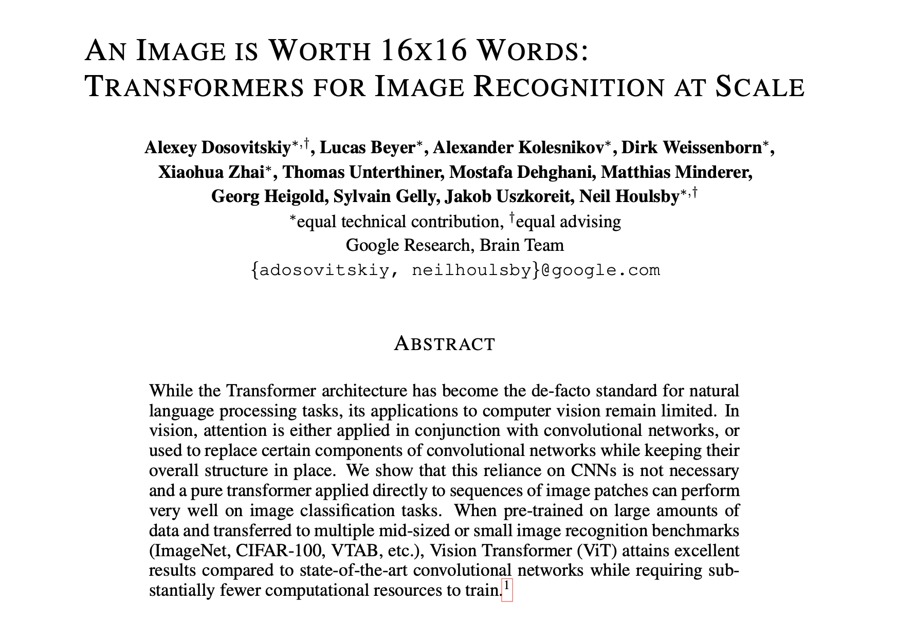








[2010.11929] An Image is Worth 16x16 Words: Transformers for Image Recognition at Scale (arxiv.org)

Slide 6
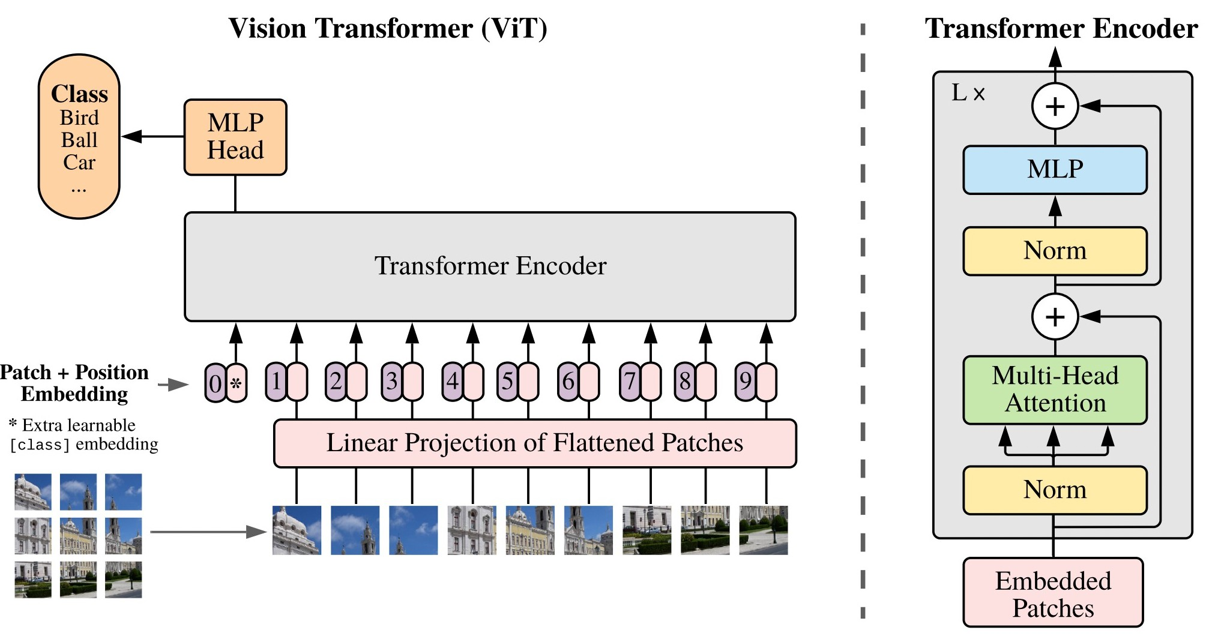
Vision Transformers Architecture: Uses Popular BERT Architecture
Dosovitskiy et al. An Image is Worth 16x16 Words: Transformers for Image Recognition at Scale. ICLR 2021.

Slide 7
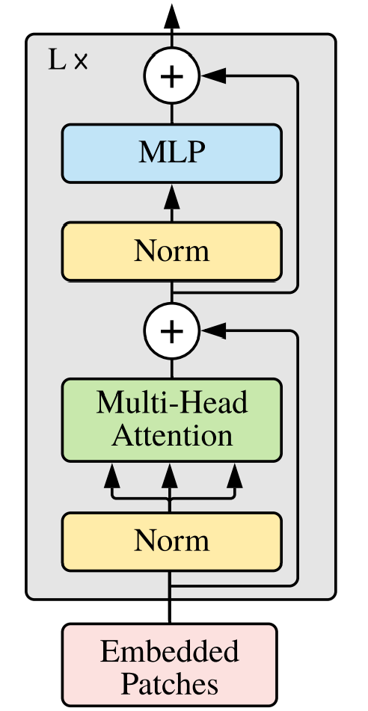
Transformer Encoder
Five key ideas
Compute-heavy blocks
Optimisation blocks
Multi-Layer Perceptron
Residual Connections
Help gradients flow
Allows embeddings to "think" independently
Layer Normalisation
Multi-Head Attention
Allows embeddings to communicate
Stabilise learning
Positional Embeddings
Allows transformer to identify embeddings
References/Image credits
Dosovitskiy et al., “An Image is Worth 16x16 Words: Transformers for Image Recognition at Scale”, ICLR (2021) Credit for "communicate/think" metaphor - Andrej Karpathy

Slide 8
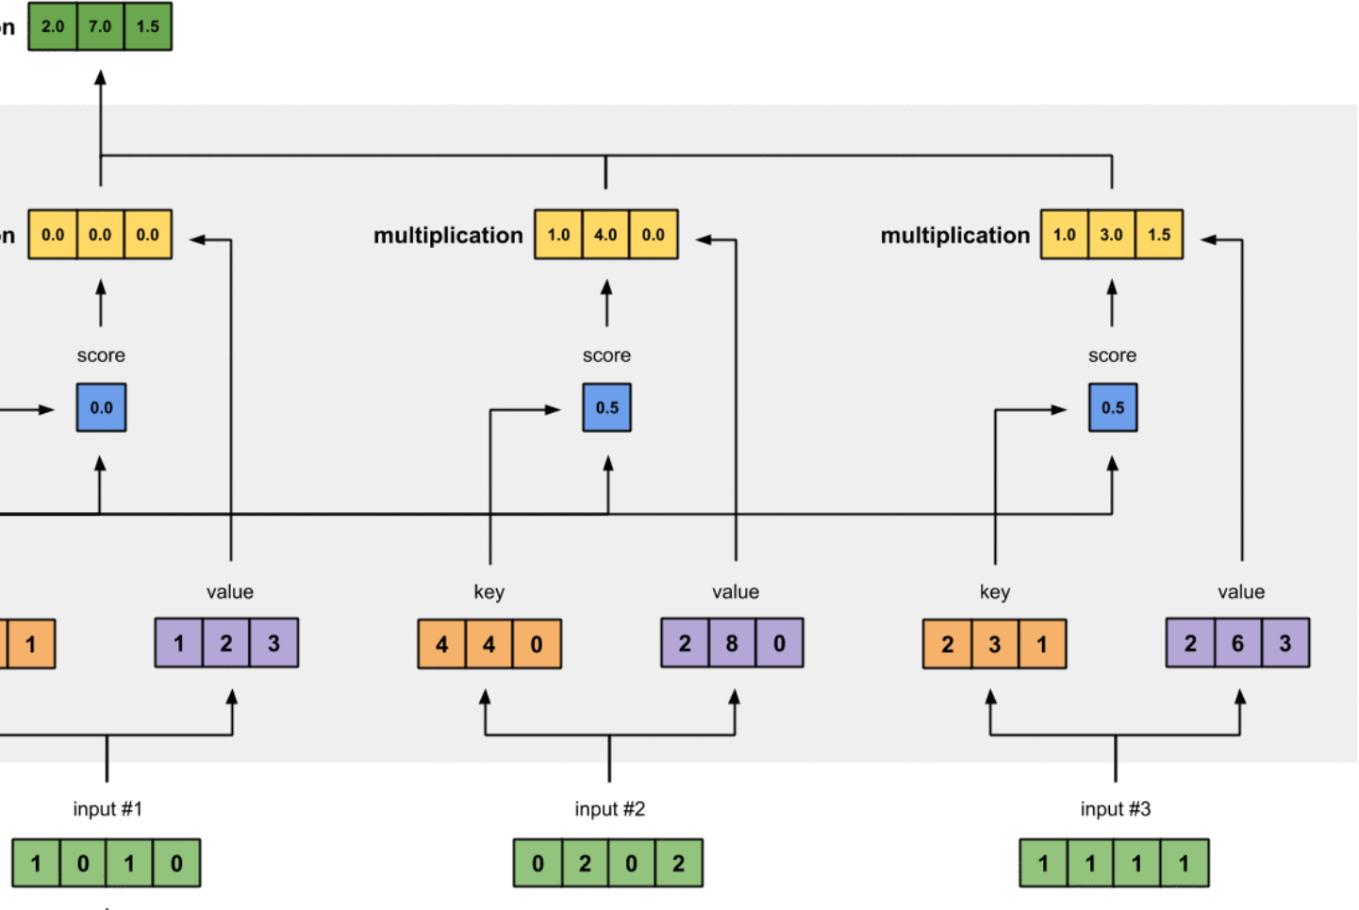
Computing Self-Attention: Example
New representation of each input token to reflect each one’s relationship to all tokens
Weighted sum of values
Input tokens
https://towardsdatascience.com/illustrated-self-attention-2d627e33b20a

Slide 9
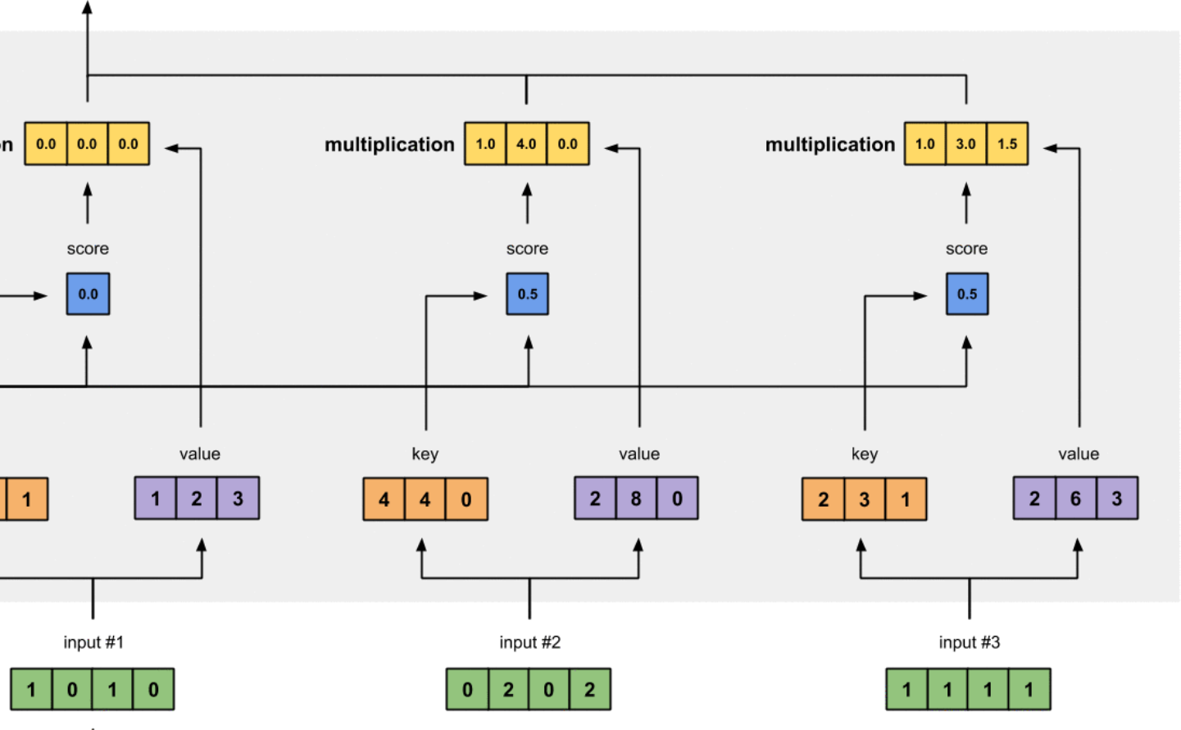
Computing Self-Attention: Example
https://towardsdatascience.com/illustrated-self-attention-2d627e33b20a

Slide 10
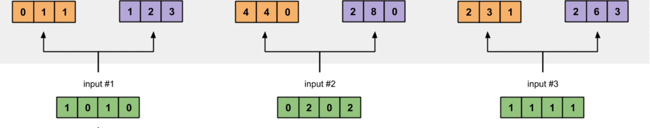

Computing Self-Attention: Example
Key 1:
Value 1:
Key 2:
Value 2:
Key 3:
Value 3:
Three vectors are derived for each input by multiplying with three weight matrices (learned during training): query, key, and value
Query 1:
Query 2:
Query 3:
https://towardsdatascience.com/illustrated-self-attention-2d627e33b20a

Slide 11
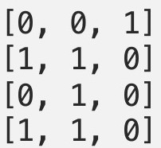
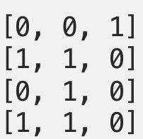
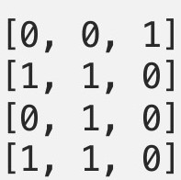
Computing Self-Attention: Example
e.g., key weights
Key 1:
Value 1:
Key 2:
Value 2:
Key 3:
Value 3:
x
x
x
https://towardsdatascience.com/illustrated-self-attention-2d627e33b20a

Slide 12
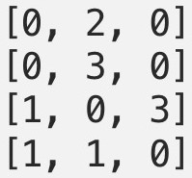
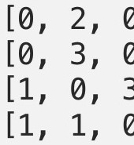
Computing Self-Attention: Example
e.g., value weights
Key 1:
Value 1:
Key 2:
Value 2:
Key 3:
Value 3:
x
x
x
https://towardsdatascience.com/illustrated-self-attention-2d627e33b20a

Slide 13
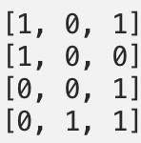
Computing Self-Attention: Example
e.g., query weights
Key 1:
Value 1:
Key 2:
Value 2:
Key 3:
Value 3:
Query 1:
Query 2:
Query 3:
https://towardsdatascience.com/illustrated-self-attention-2d627e33b20a

Slide 14
Computing Self-Attention: Example
Key 1:
Value 1:
Key 2:
Value 2:
Key 3:
Value 3:
Query 1:
Query 2:
Query 3:
https://towardsdatascience.com/illustrated-self-attention-2d627e33b20a

Slide 15
Computing Self-Attention: Example
What is the purpose of the three weight matrices?
Key 1:
Value 1:
Key 2:
Value 2:
Key 3:
Value 3:
For each input, 2 of the derived vectors are used to compute attention weights (query and key) and the 3rd is information passed on for the new representation (value)
Query 1:
Query 2:
Query 3:
https://towardsdatascience.com/illustrated-self-attention-2d627e33b20a

Slide 16
Computing Self-Attention: Example
Key 1:
Value 1:
Key 2:
Value 2:
Key 3:
Value 3:
We now will examine how to find the new representation for the first input.
Query 1:
Query 2:
Query 3:
https://towardsdatascience.com/illustrated-self-attention-2d627e33b20a

Slide 17
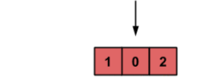
Computing Self-Attention: Example
Attention score: dot product of query with all keys to identify relevant tokens; e.g.,
x = ?
1 | 0 | 2
0
1
1
Key 1:
Value 1:
Key 2:
Value 2:
Key 3:
Value 3:
Query 1:
https://towardsdatascience.com/illustrated-self-attention-2d627e33b20a

Slide 18
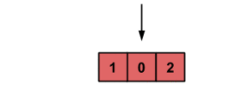
Computing Self-Attention: Example
Attention score: dot product of query with all keys to identify relevant tokens; e.g.,
x = ?
1 | 0 | 2
4
4
0
Key 1:
Value 1:
Key 2:
Value 2:
Key 3:
Value 3:
Query 1:
https://towardsdatascience.com/illustrated-self-attention-2d627e33b20a

Slide 19

Computing Self-Attention: Example
Attention score: dot product of query with all keys to identify relevant tokens; e.g.,
x = ?
1 | 0 | 2
2
3
1
Key 1:
Value 1:
Key 2:
Value 2:
Key 3:
Value 3:
Query 1:
https://towardsdatascience.com/illustrated-self-attention-2d627e33b20a

Slide 20
Computing Self-Attention: Example
Why dot product? Indicates similarity of two vectors
Match = 1 (i.e., cos(0))
Opposites = -1 (i.e., cos(180))
Key 1:
Value 1:
Key 2:
Value 2:
Key 3:
Value 3:
To which input(s) is input 1
most related?
Query 1:
https://towardsdatascience.com/illustrated-self-attention-2d627e33b20a

Slide 21
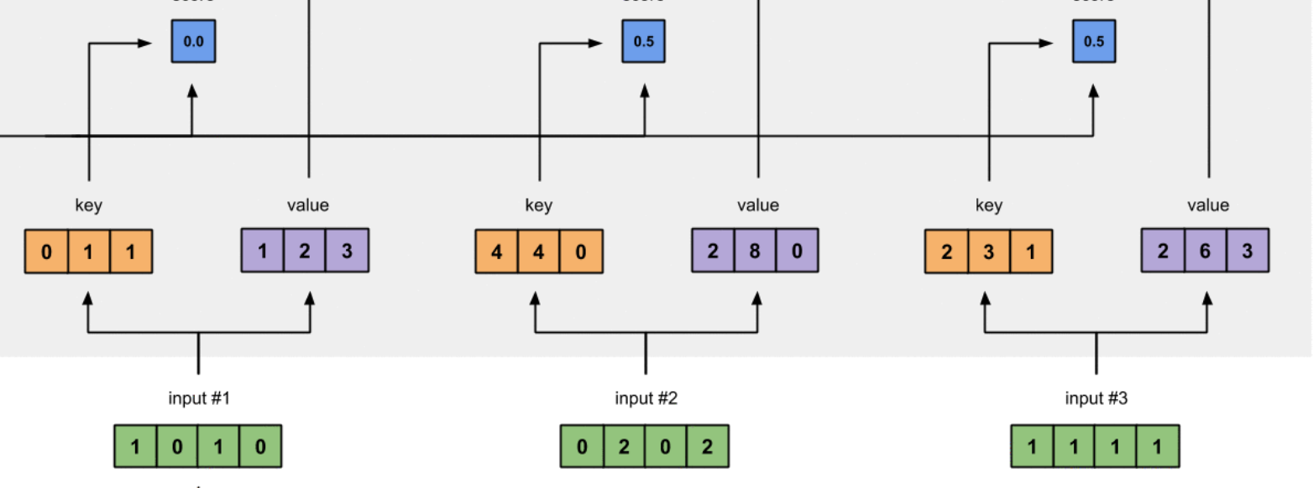

Computing Self-Attention: Example
Attention weights: softmax scores for all inputs to quantify
each token’s relevance; e.g.,
= softmax([2, 4, 4])
0.0 0.5 0.5
= [0.0, 0.5, 0.5])
Note: softmax doesn’t return 0, but can arise from rounding
Key 1:
Value 1:
Key 2:
Value 2:
Key 3:
Value 3:
Query 1:
https://towardsdatascience.com/illustrated-self-attention-2d627e33b20a

Slide 22
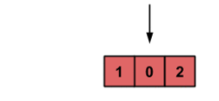
Computing Self-Attention: Example
Compute new representation of input token that reflects entire input:
0.0 0.0 0.0 1.0 4.0 0.0 1.0 3.0 1.5
1. Attention weights x Values
0.0
0.5
0.5
Key 1:
Value 1:
Key 2:
Value 2:
Key 3:
Value 3:
Query 1:
https://towardsdatascience.com/illustrated-self-attention-2d627e33b20a

Slide 23
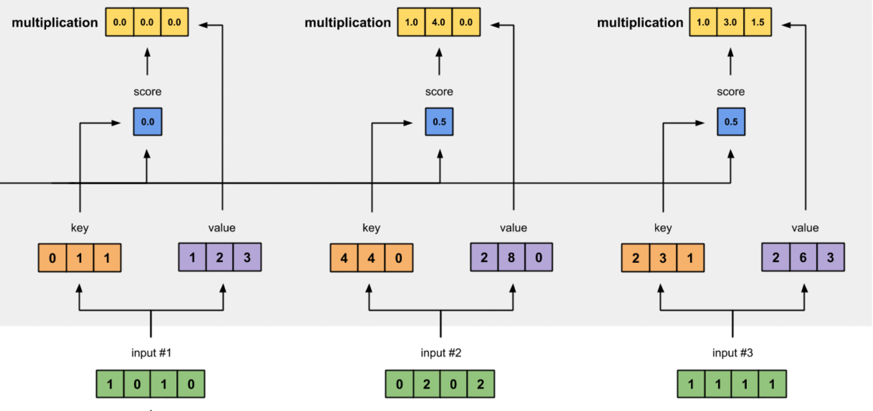
Computing Self-Attention: Example
Compute new representation of input token that reflects entire input:
2.0 | 7.0 | 1.5
0.0
0.0
0.0
1.0
4.0
0.0
1.0
3.0
1.5
1. Attention weights x Values
0.0
0.5
0.5
2. Sum all weighted vectors
Key 1:
Value 1:
Key 2:
Value 2:
Key 3:
Value 3:
To which input(s) is input 1
most related?
Query 1:
https://towardsdatascience.com/illustrated-self-attention-2d627e33b20a

Slide 24
Computing Self-Attention: Example
2.0 | 7.0 | 1.5
0.0
0.0
0.0
1.0
4.0
0.0
1.0
3.0
1.5
Attention weights amplify input representations (values) that we want to pay attention to and repress the rest
0.0
0.5
0.5
Key 1:
Value 1:
Key 2:
Value 2:
Key 3:
Value 3:
Query 1:
https://towardsdatascience.com/illustrated-self-attention-2d627e33b20a

Slide 25
Computing Self-Attention: Example
2.0 | 7.0 | 1.5
0.0
0.0
0.0
1.0
4.0
0.0
1.0
3.0
1.5
Attention weights amplify input representations (values) that we want to pay attention to and repress the rest
0.0
0.5
0.5
Key 1:
Value 1:
Key 2:
Value 2:
Key 3:
Value 3:
Query 1:
https://towardsdatascience.com/illustrated-self-attention-2d627e33b20a

Slide 26
Computing Self-Attention: Example
Repeat the same process for each remaining input token
Key 1:
Value 1:
Key 2:
Value 2:
Key 3:
Value 3:
Query 1:
Query 2:
Query 3:
https://towardsdatascience.com/illustrated-self-attention-2d627e33b20a

Slide 27
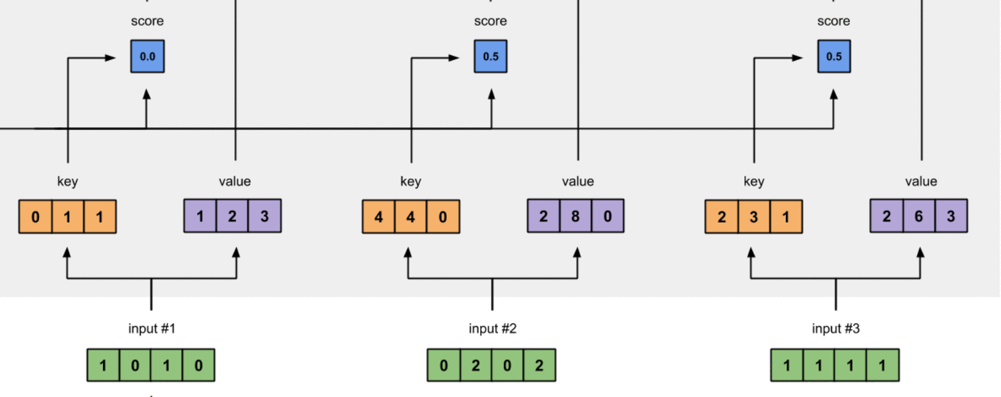
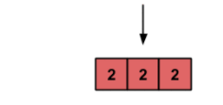
Computing Self-Attention: Example
0.0 1.0 0.0
1. Compute attention weights
- Softmax resulting 3 scores from query x keys
Key 1:
Value 1:
Key 2:
Value 2:
Key 3:
Value 3:
To which input(s) is input 2
most related?
Query 2:
https://towardsdatascience.com/illustrated-self-attention-2d627e33b20a

Slide 28
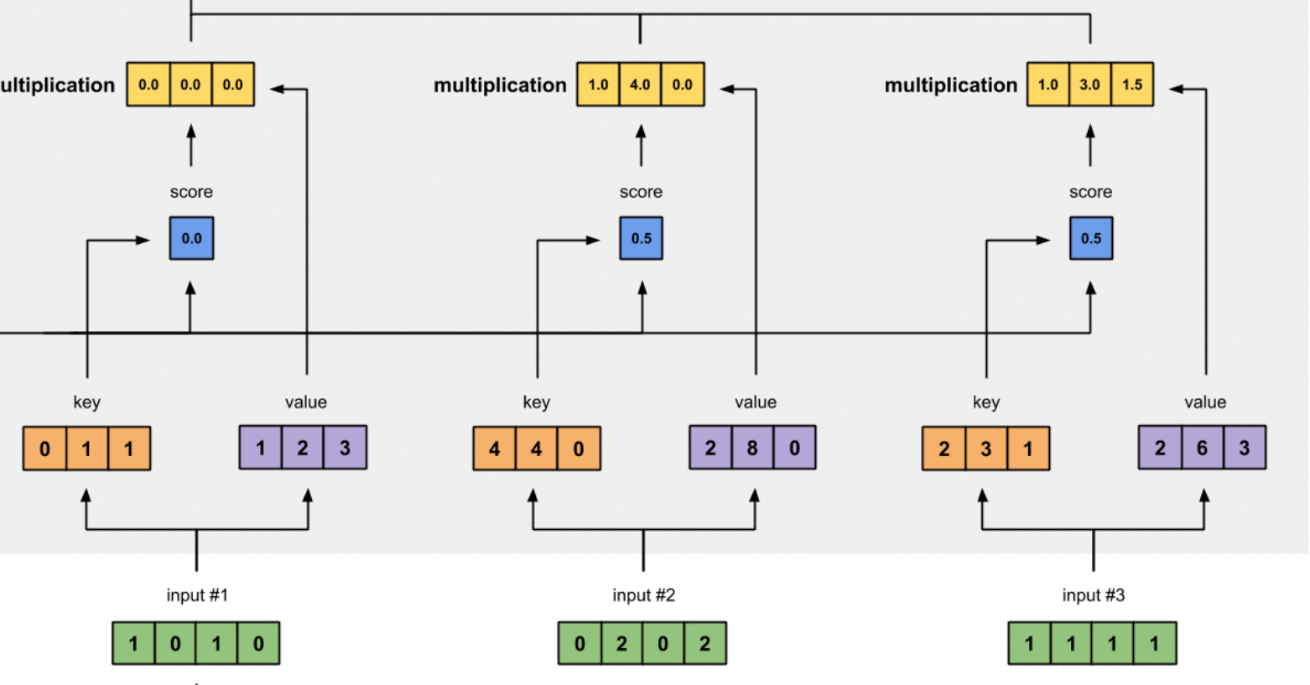
Computing Self-Attention: Example
2.0 8.0 0.0
0.0 0.0 0.0 2.0 8.0 0.0 0.0 0.0 0.0
0.0
1.0
0.0
1. Compute attention weights
- Softmax resulting 3 scores from query x keys
Key 1:
Value 1:
Key 2:
Value 2:
Key 3:
Value 3:
2. Compute weighted sum of
values using attention scores
Query 2:
https://towardsdatascience.com/illustrated-self-attention-2d627e33b20a

Slide 29
Computing Self-Attention: Example
Repeat the same process for each remaining input token
Key 1:
Value 1:
Key 2:
Value 2:
Key 3:
Value 3:
Query 1:
Query 2:
Query 3:
https://towardsdatascience.com/illustrated-self-attention-2d627e33b20a

Slide 30
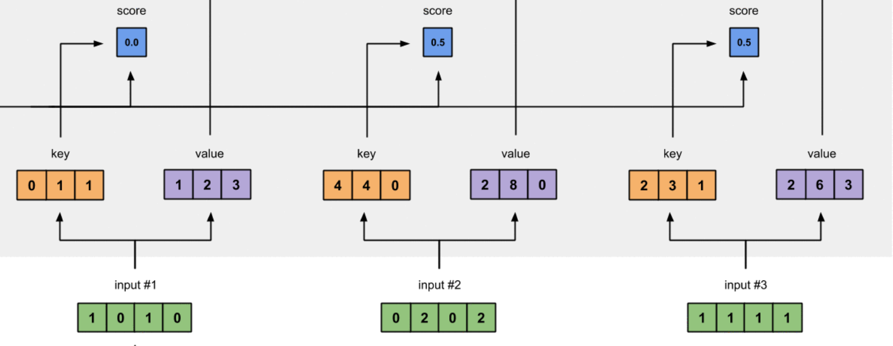
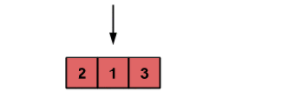
Computing Self-Attention: Example
0.0 0.9 0.1
1. Compute attention weights
- Softmax resulting 3 scores from query x keys
Key 1:
Value 1:
Key 2:
Value 2:
Key 3:
Value 3:
To which input(s) is input 3
most related?
Query 3:
https://towardsdatascience.com/illustrated-self-attention-2d627e33b20a

Slide 31
Computing Self-Attention: Example
2.0 7.8 0.3
0.0 0.0 0.0 1.8 7.2 0.0 0.2 0.6 0.3
0.0
0.9
0.1
1. Compute attention weights
- Softmax resulting 3 scores from query x keys
Key 1:
Value 1:
Key 2:
Value 2:
Key 3:
Value 3:
2. Compute weighted sum of
values using attention scores
Query 2:
https://towardsdatascience.com/illustrated-self-attention-2d627e33b20a

Slide 32
Computing Self-Attention: Example
2.0 | 7.0 | 1.0
2.0 | 8.0 | 0.0
2.0 | 7.8 | 0.3
Key 1:
Value 1:
Key 2:
Value 2:
Key 3:
Value 3:
Query 1:
Query 2:
Query 3:
https://towardsdatascience.com/illustrated-self-attention-2d627e33b20a

Slide 33
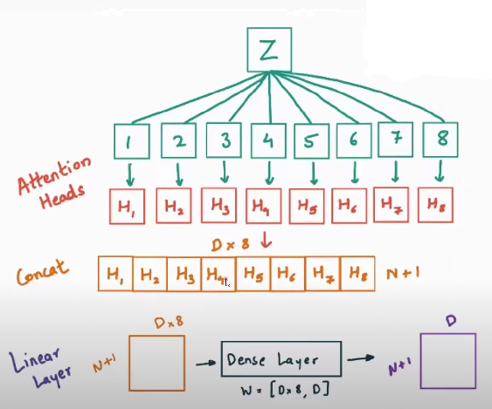
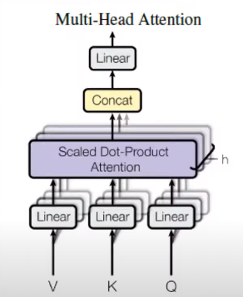
Computing Multi-Head Attention: Example

Slide 34
ViT Solution: Input Patches Instead of Pixels
Dosovitskiy et al. An Image is Worth 16x16 Words: Transformers for Image Recognition at Scale. ICLR 2021.

Slide 35
ViT Solution: Use [CLS] for Image Classification
[CLS] token represents entire image
Dosovitskiy et al. An Image is Worth 16x16 Words: Transformers for Image Recognition at Scale. ICLR 2021.

Slide 36
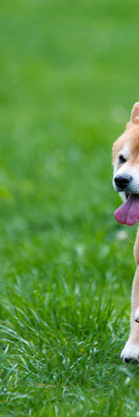
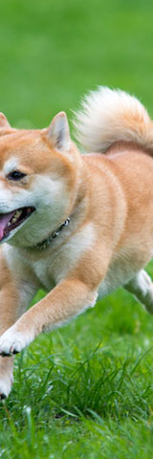
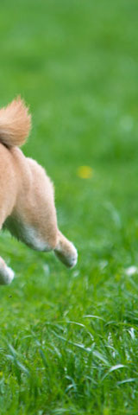
Standard Transformer on Patches
Dosovitskiy et al, “An Image is Worth 16x16 Words: Transformers for Image Recognition at Scale”, ICLR 2021
Dog image is free for use
Image Ref. http://wangshusen.github.io/

Slide 37
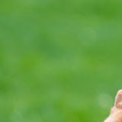





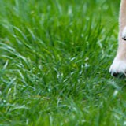
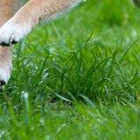

Standard Transformer on Patches
Split Image into Patches
Here, the patches do not overlap.
The patches can overlap.
User specifies:
patch size, e.g., 16×16;
stride, e.g., 16×16.
9 input patches, each of shape 3x16x16
Dosovitskiy et al, “An Image is Worth 16x16 Words: Transformers for Image Recognition at Scale”, ICLR 2021
Dog image is free for use
Image Ref. http://wangshusen.github.io/

Slide 38
Vectorization
Vision Transformer Architecture Explained:
If the patches are 𝑑₁×𝑑₂×𝑑₃ tensors, then the vectors are 𝑑₁𝑑₂𝑑₃×1.
𝐱₁
𝐱₂
𝐱₃
𝐱₄
𝐱₅
𝐱₆
𝐱₇
𝐱₈
𝐱₉

Slide 39

𝐳₁ = 𝐖 𝐱₁ + 𝐛
Vision Transformer Architecture Explained:
Dense
𝐱₁
𝐱₂
𝐱₃
⋯
𝐱_{𝑛}

Slide 40
𝐳₂ = 𝐖 𝐱₂ + 𝐛
Vision Transformer Architecture Explained:
𝐳₁
Dense
Dense
𝐱₁
𝐱₂
𝐱₃
⋯
𝐱_{𝑛}

Slide 41
Vision Transformer Architecture Explained:
Linear projection to D-dimensional vector
N input patches, each of shape 3x16x16
𝐳₁
𝐳₂
𝐳₃
⋯
𝐳_{𝑛}
⋯
Share Parameters
Dense
Dense
Dense
Dense
𝐱₁
𝐱₂
𝐱₃
⋯
𝐱_{𝑛}

Slide 42
Vision Transformer Architecture Explained:
Add positional embedding: learned D- dim vector per position
1
2
3
𝑛
Positional Encoding:
⋯
𝐳₁
𝐳₂
𝐳₃
⋯
𝐳_{𝑛}
Dense
Dense
Dense
⋯
Dense
𝐱₁
𝐱₂
𝐱₃
⋯
𝐱_{𝑛}

Slide 43
Add positional encoding vectors to 𝐳₁, 𝐳₂, ⋯ , 𝐳_{𝑛}.
Vision Transformer Architecture Explained:
⋯
𝐳₁
𝐳₂
𝐳₃
⋯
𝐳_{𝑛}
Dense
Dense
Dense
⋯
Dense
𝐱₁
𝐱₂
𝐱₃
⋯
𝐱_{𝑛}

Slide 44



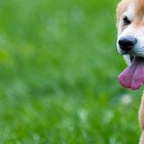
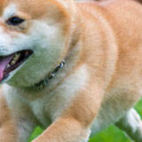

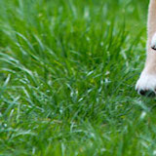
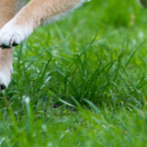
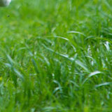
Add positional encoding vectors to 𝐳₁, 𝐳₂, ⋯ , 𝐳_{𝑛}. (Why?)
Vision Transformer Architecture Explained:
3% drop in accuracy is observed, if we do not apply positional encoding
Positional encoding encoding can be 1D or 2D, but no significant improvement is found in using 2D encoding, hence the paper uses 1D position encoding
①
②
③
① ③
②
𝐳₁ 𝐳₂ 𝐳_{3 ⋯} 𝐳_{𝑛}
Dense Dense Dense ⋯⋯ Dense
^{𝐱}1 ^{𝐱}2 ^{𝐱}3 ⋯ ^{𝐱}𝑛
④
⑤
⑥
④
⑤ ⑥
⑧
⑨
⑦ ⑧
⑨
Image Ref. http://wangshusen.github.io/

Slide 45
𝐜_{𝑛}
Vision Transformer Architecture Explained:
𝐜₀
𝐜₁
𝐜₂
𝐜₃
⋯
Transformer Encoder Network
𝐳₀
𝐳₁
𝐳₂
𝐳₃
⋯
𝐳_{𝑛}
Embed
Dense
Dense
Dense
⋯
Dense
[CLS]
𝐱₁
𝐱₂
𝐱₃
⋯
𝐱_{𝑛}

Slide 46
Vision Transformer Architecture Explained:
𝐜₀
𝐜₁ 𝐜₂ 𝐜_{3 ⋯} 𝐜_{𝑛}
Transformer Encoder Network
𝐳₀
𝐳₁
𝐳₂
𝐳₃
⋯
𝐳_{𝑛}
Embed
Dense
Dense
Dense
⋯
Dense
[CLS]
𝐱₁
𝐱₂
𝐱₃
⋯
𝐱_{𝑛}

Slide 47
Vision Transformer Architecture Explained:
MLP head is implemented one hidden layer and tanh as non linearity at pre-training time and by a single linear layer at fine tuning time. For classification task we are just interested in the first context token(C0).
MLP
Head
𝐩
𝐜
0
Class
Transformer Encoder Network
𝐳₀
𝐳₁
𝐳₂
𝐳₃
⋯
𝐳_{𝑛}
Embed
Dense
Dense
Dense
⋯
Dense
[CLS]
𝐱₁
𝐱₂
𝐱₃
⋯
𝐱_{𝑛}

Slide 48
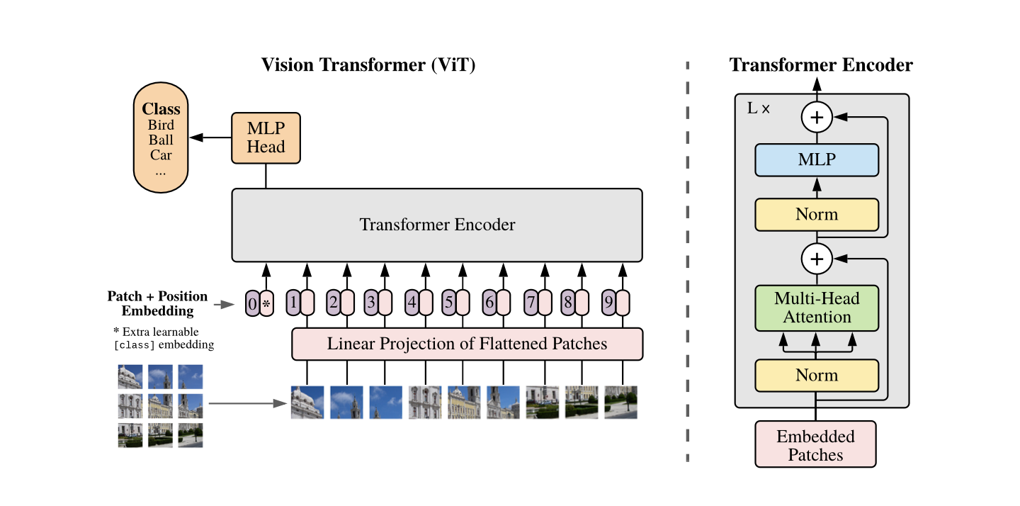
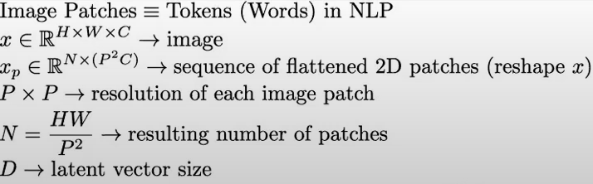
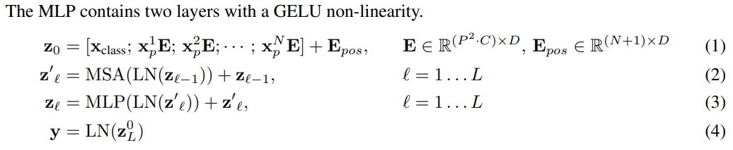
Vision Transformer Architecture

Slide 49




































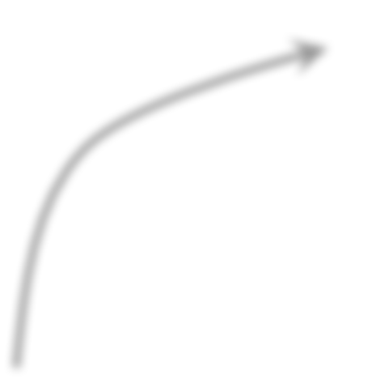





















Randomly Initialized
Training:
Fine-tuned
Pretrained
Test Accuracy
Training Set of Dataset B
Test Set of Dataset B
Dataset A

Slide 50
Self-supervision:
Most of Transformers success in NLP is the result of large-scale self-supervised pre-training where Transformer is trained on massive unlabelled data from the web.
Using masked work prediction technique that were used in BERT(randomly masking words in input sentence), ViT designers also tried the same technique where they masked 50% of patches(masked patch prediction) but achieved less performance than supervised pre-training(79.9% ACC on ImageNet while supervised pre-training is ~85%).
Masked-word prediction in BERT
Masked patch prediction ViT
Transformer is an efficient deep learning architecture
Transformer Encoder
ViT
Transformer is an efficient deep learning architecture

Slide 51
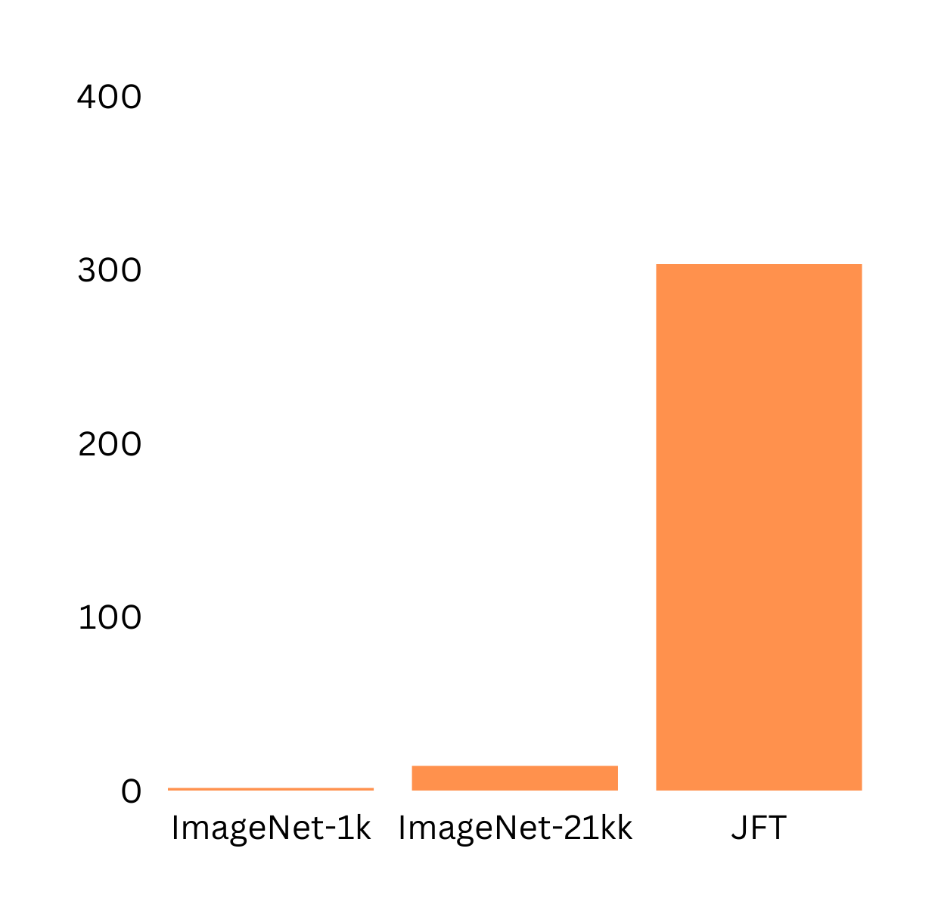
Training Dataset Vision Transformer
Vision Transformer(ViT) was pre-trained on 3 datasets of varying size and scale.
Pre-training datasets
303M
ImageNet-1K: 1.3M images, 1K classes
ImageNet-21k: 14M images, 21K classes
JFT: 303M images, 18K classes
No of images in millions(M)
1.3M
14M
ImageNet-1k and ImageNet-21K are also used for fine-tuning!
Datasets

Slide 52
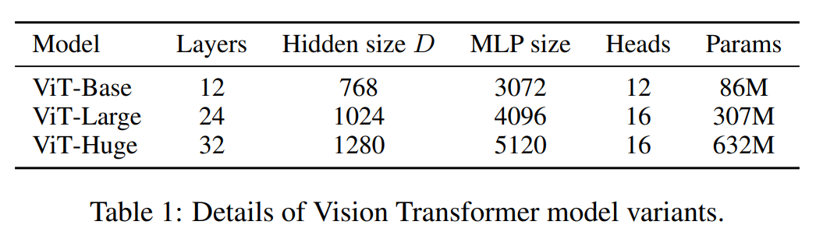
Pre-Training Vision Transformer
Vision Transformer(ViT) was pre-trained with same configurations of as BERT.
All the models are pre-trained using ADAM optimizer with batch size of 4096

Slide 53
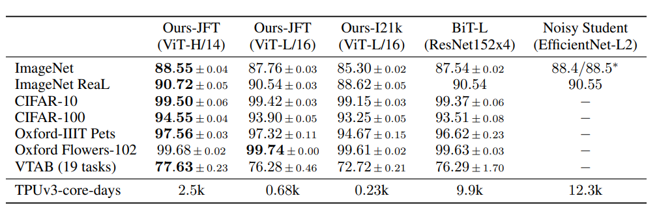
Fine-Tuning Vision Transformer
All the models are fine tuned using SGD optimizer with monentum and batch size of 512 for ViT-L/16 and 518 for ViT-H/14.

Slide 54
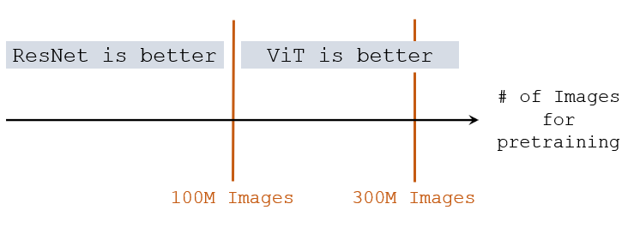
Image Classification Accuracies
Pretrained on ImageNet (small), ViT is slightly worse than ResNet.
Pretrained on ImageNet-21K (medium), ViT is comparable to ResNet.
Pretrained on JFT (large), ViT is slightly better than ResNet.

Slide 55
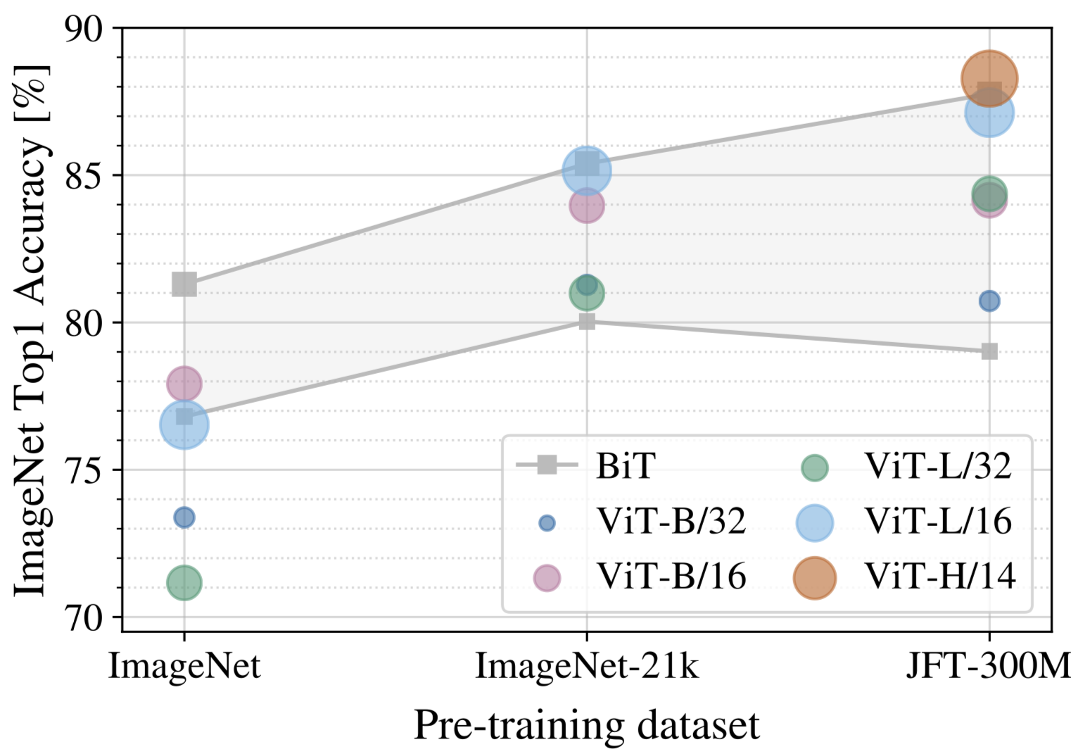
Vision Transformer vs SOTA CNN(ResNet)
Results
On small pre-training dataset(ImageNet-1k, 1.3M images), ResNet performs better than ViT due to CNN spatial inductive biases that compensate for small dataset.
On medium pre-training dataset(Imagenet-21k, 14M images), ViTs and ResNet performance are almost similar although ViTs perform slightly better.
On large pre-training dataset(JFT, 303M images), large ViT outperforms ResNet and show no sign of plateau.
B: Base, L: Large, H: Huge
14, 16, 32: Patch size(the smaller patch size, the more the patches, and the bigger the model) >> N = HW/PP
Ex: ViT-B/16: Base ViT with 16x16 patch size

Slide 56
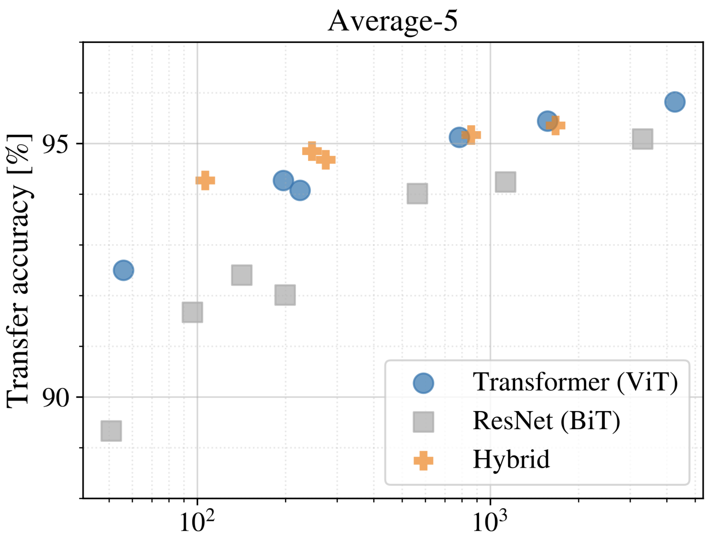
Vision Transformer vs SOTA CNN(ResNet)
Pre-training compute
ViT clearly outperforms ResNet on performance/compute trade-off.
ViT uses approximately 2-4x less compute to achieve the same transfer accuracy(average of all downstream datasets).
Hybrid(CNN+ViT) slightly outperforms ViT on relatively small compute, but vanishes on large compute budget.
ViT shows extreme scaling behavior. Its performance doesn’t seem to saturate for increased compute.
Pre-training compute(in ExaFLOPs)
Exa: 10¹⁸, 1 FLOP = 1 multiply-add(wx+b) per second
FLOPs: floating point operations per second

Slide 57
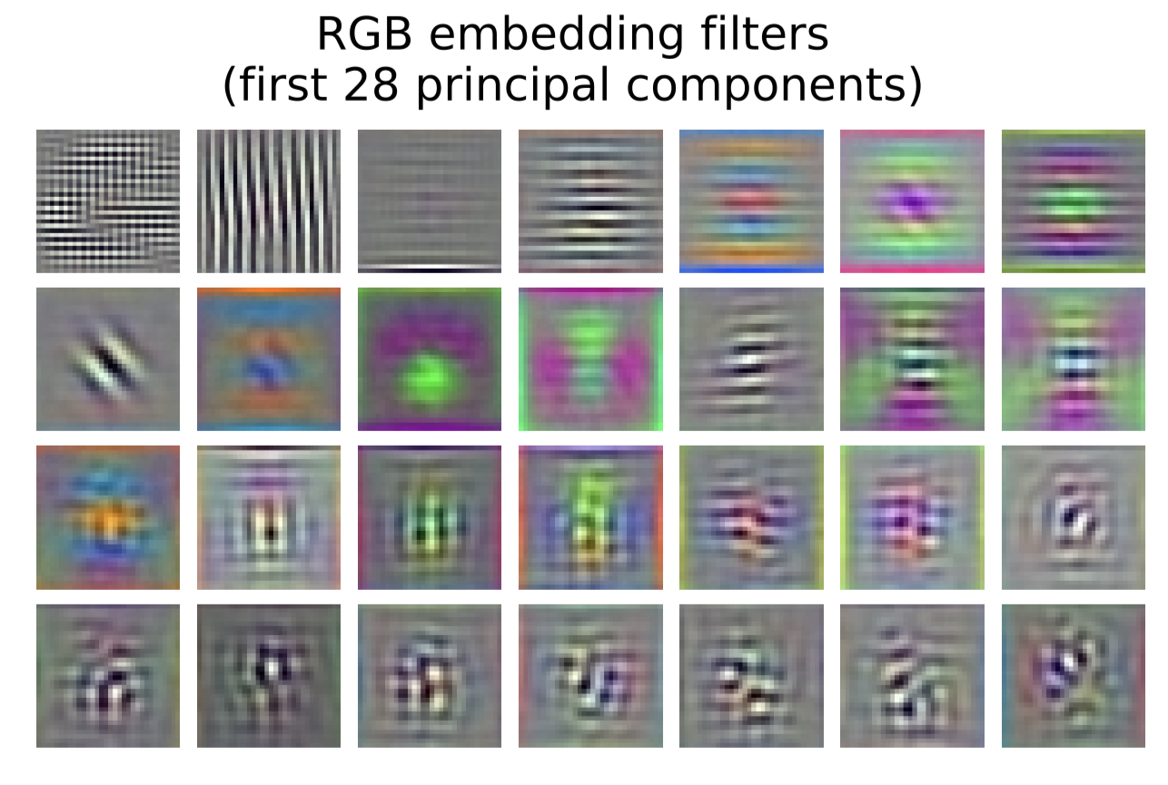
Inspecting ViT Representation
Vision Transformer shows remarkable performance when trained on massive datasets.
The visualized linear embedding of flattened patches shows that the first layer of ViT(linear projection) learns the low level features(such as edges, blobs) of the input image much like ConvNets do!

Slide 58
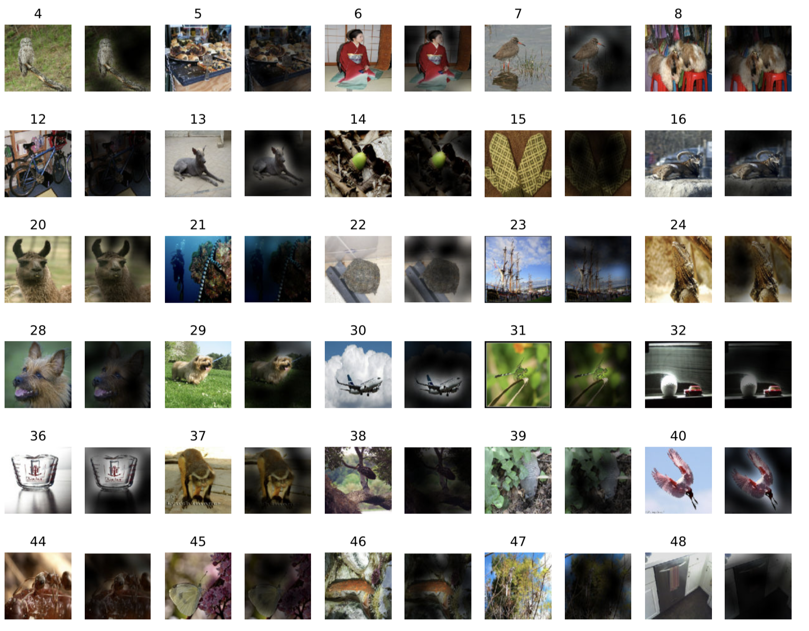
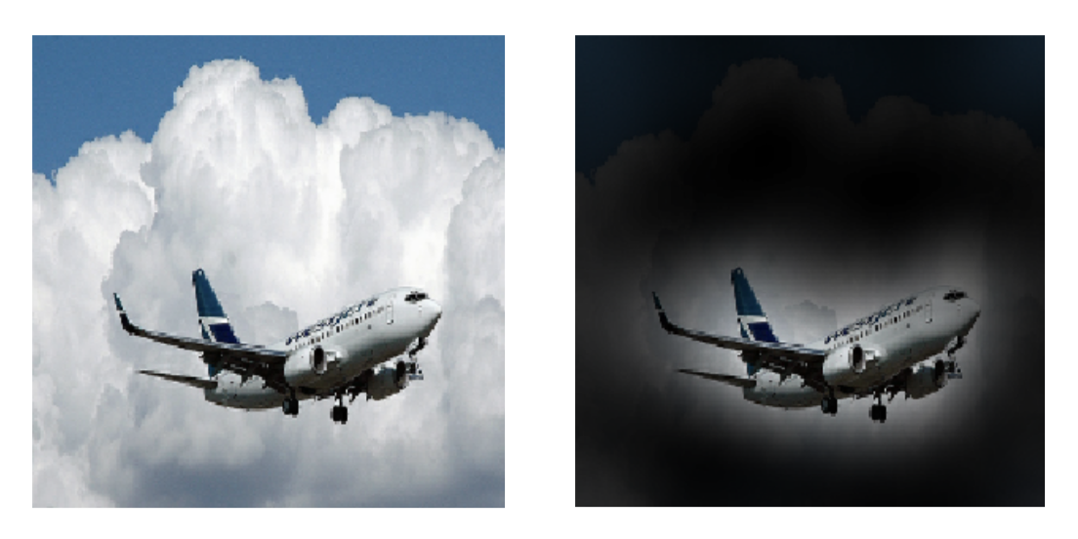
Inspecting ViT Representation
Vision Transformer shows remarkable performance when trained on massive datasets. How does it processes images internally?
On global level, ViT attends to the meaningful part of the image and ignore the rest.

Slide 59
Conclusion
Vison Transformer matches or exceeds the state of art on many image classification datasets, while being relatively cheap to pre-train.
While initial results are encouraging, we need to analyse the performane of ViT on other computer vison tasks, such as detection and segmentation.

Slide 60

End of the video
Image: Google AI blog

Slide 61
Thank You!

